Slide 1

Web Application Security
“Most Common Vulnerabilities”
Presented By
Hamza Alkofahi
Auburn Cyber Research Center

Slide 2
Common Web Application Vulnerabilities
Injection flaws.
Cross Site Scripting (XSS).
Insecure Direct Object References.
Security misconfiguration.
Cross Site Request Forgery (CSRF).
Using components with known vulnerabilities.

Slide 3

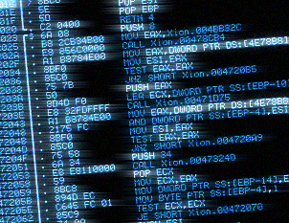
Some Definitions
Vulnerability: A flaw or weakness in a system's design, implementation, or operation and management that could be exploited to violate the system's security policy.
Exploit: it’s a piece of software, a chunk of data, or a sequence of commands that takes advantage of a bug or vulnerability in order to cause unintended or unanticipated behavior to occur on computer software,hardware, or something electronic.

Slide 4

Injection Flaws
Occurs when untrusted data is sent to an interpreter as part of a command or query, that can trick the interpreter into executing unintended commands or accessing data without proper authorization.
Such as:
SQL injection
Command Injection

Slide 5
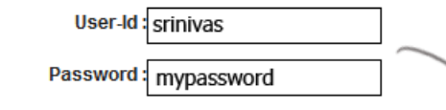


SQL injection
$sql = "SELECT * FROM Users where user_id='" + $user_id + "' and password = '" + $password +"'";
$result = mysqli_query($conn, $sql);
if (mysqli_num_rows($result) > 0) {
//Do something
}

Slide 6
SQL injection (Cont.)
Comment styles in MySQL:
mysql> SELECT 1+1; -- This comment continues to the end of line
result: 2
mysql> SELECT 1 /* this is an in-line comment */ + 1;
result: 2

Slide 7
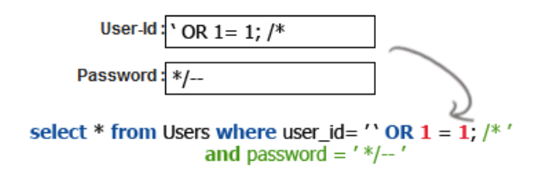
SQL injection (Cont.)

Slide 8
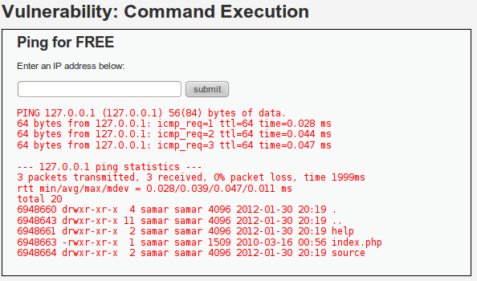
Command Injection
127.0.0.1
echo exec($ipAddress);

Slide 9
Command Injection (Cont.)
127.0.0.1; ls -l

Slide 10
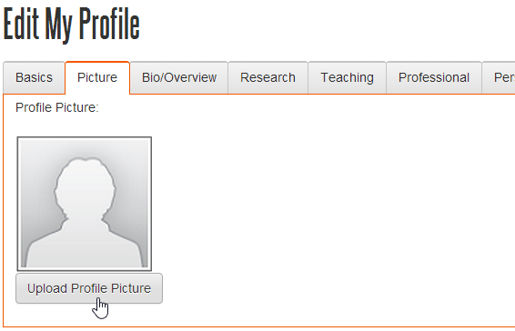

Command Injection (Cont.)
supported by php

Slide 11
Cross Site Scripting (XSS)

Slide 12
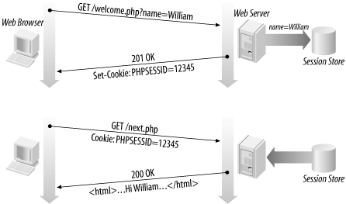

Cookies and Sessions

Slide 13
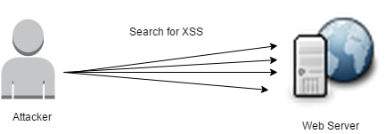
Cross Site Scripting (XSS)
An attacker gives your web application JavaScript tags on input. When this input is returned to the user, the user’s browser will execute it.
Such as :
Reflected XSS
Stored XSS

Slide 14
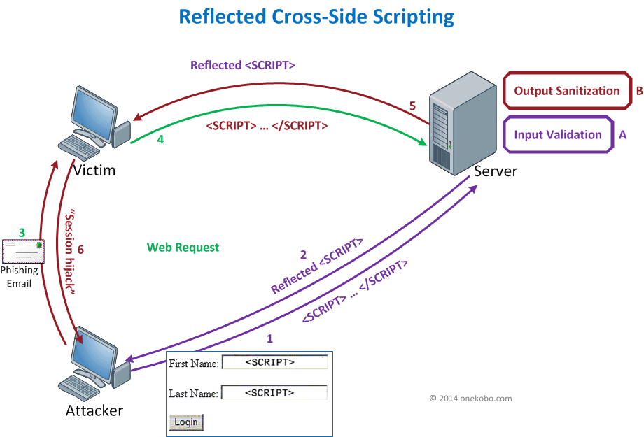
Reflected XSS

Slide 15
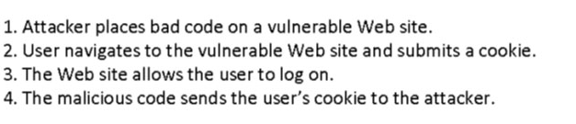
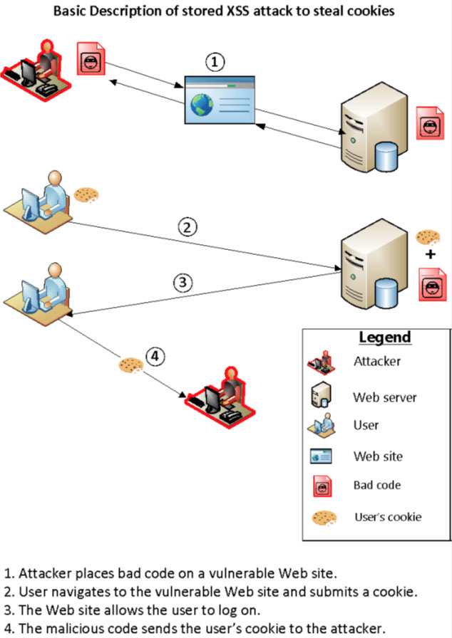
Stored XSS
Ex: Blog > articles > malicious comment

Slide 16
Stored XSS (Cont.)

Slide 17


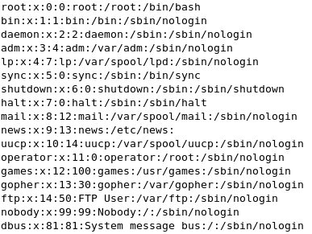
Insecure Direct Object References
This is a classic case of trusting user input and paying the price in a resulting security vulnerability. A direct object reference means that an internal object such as a file or database key is exposed to the user.
example.com/*/download.php?filename=crazyCats.mov
←---------------------------- your video
But !
example.com/*/download.php?filename=../../../../etc/passwd
←-------- passwd !!!

Slide 18
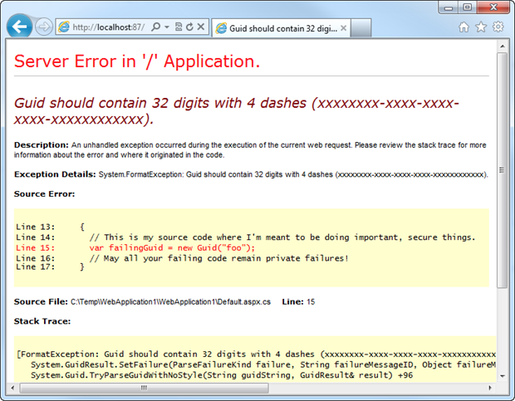
Security misconfiguration
Web servers and applications that have been misconfigured are way more common than those that have been configured properly.
Such as:
Running the application with debug enabled in production.
Having directory listing enabled on the server, which leaks valuable information.
Running outdated software (think WordPress plugins, old PhpMyAdmin).
Having unnecessary services running on the machine.
Not changing default keys and passwords.

Slide 19
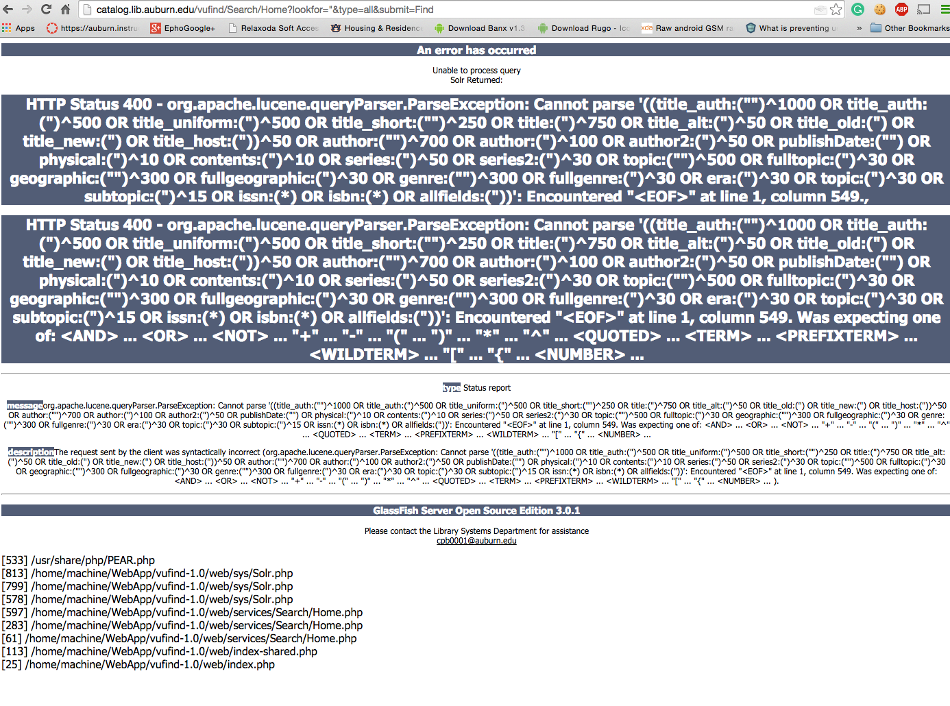
1) Running the application with debug enabled in production.

Slide 20
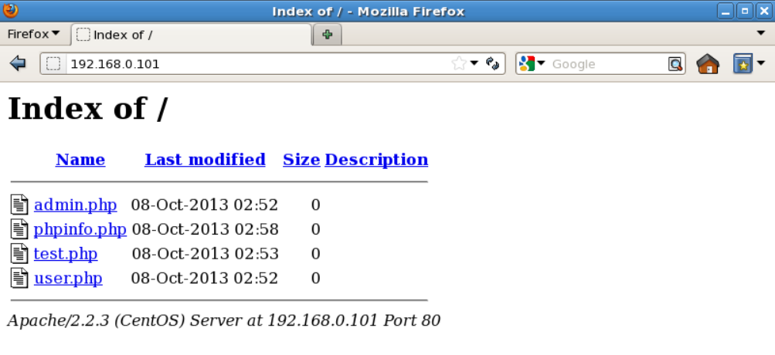
2) Having directory listing enabled on the server, which leaks valuable information.

Slide 21

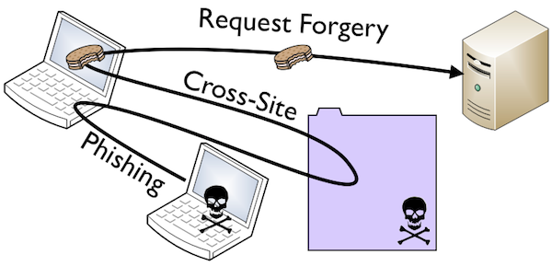
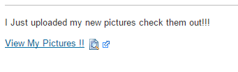
Cross Site Request Forgery (CSRF)
An attack that forces an end user to execute unwanted actions on a web application in which they're currently authenticated.
http://bank.com/transfer.do?acct=sam&amount=1000
But !!
<a href="http://bank.com/transfer.do?acct=Attacker&amount=10000">View my Pictures !! </a>

Slide 22


Using components with known vulnerabilities
OpenSSL versions before 1.0.1j, 1.0.0o and 0.9.8zc: vulnerable to poodle attack !!
OpenSSL 1.0.1 through 1.0.1f: vulnerable to heartbleed attack !!

Slide 23
References
OWASP Top 10 for 2013
10 Most common web security vulnerabilities

Slide 24
Any Question?

